Slide 1


Slide 2

Group members:
Sabiba Israt Zerin (221-15-5887)
Mst. Fatema Akter ( 221-15-6015)
Mehzabin Nower(221-15-4688)
Tamanna Akter(221-15-5298)
Saif (221-15-4897)
Samin Yeaser

Slide 3

Time & Financial Management

Slide 4


Two parts:
1. Time management ​ 2. financial management​

Slide 5

What do we mean by time management?

Slide 6

Why do we need time management?
To save time
To reduce stress
To function effectively
To increase our work output
To have more control over our job responsibilities

Slide 7

Effective planning
Setting goals and objectives
Setting deadlines
Delegation of responsibilities
Spending right time on the right activities

Slide 8
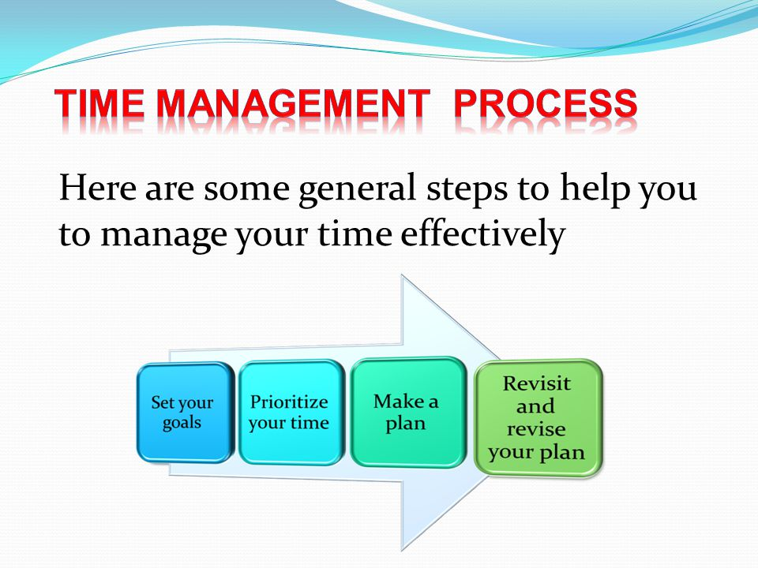

Slide 9
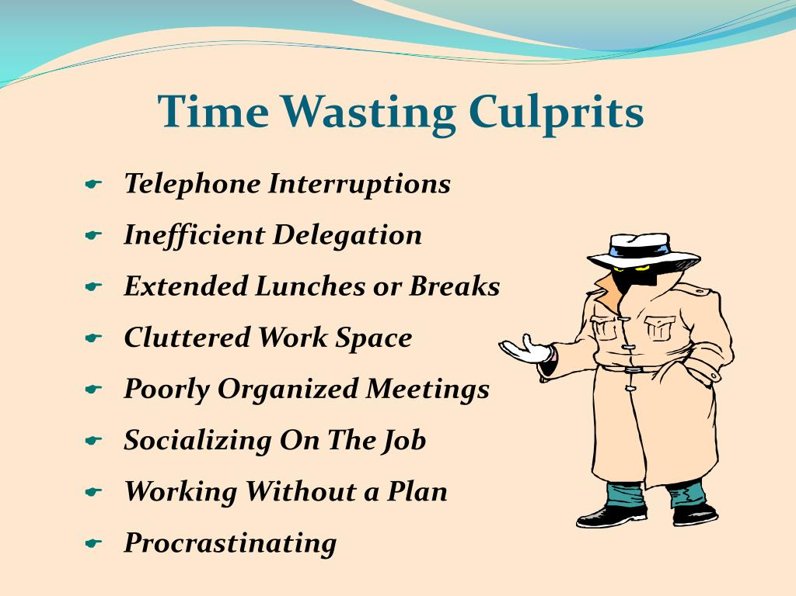
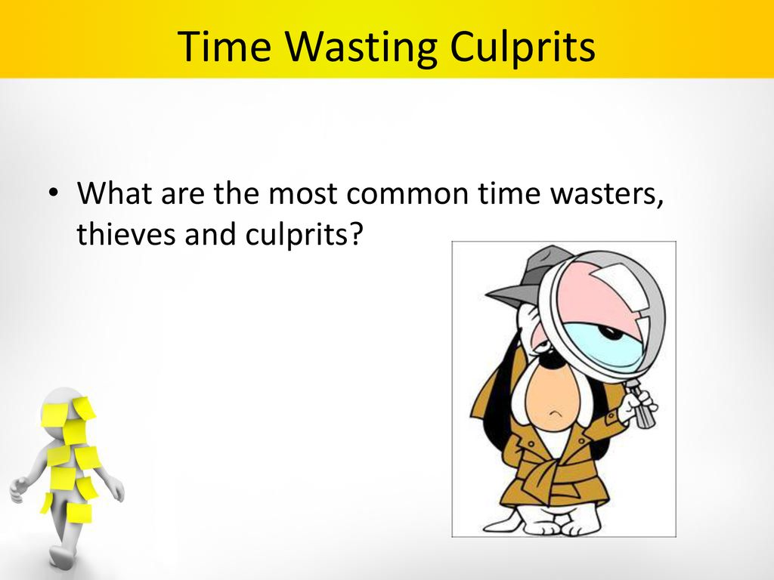

Slide 10
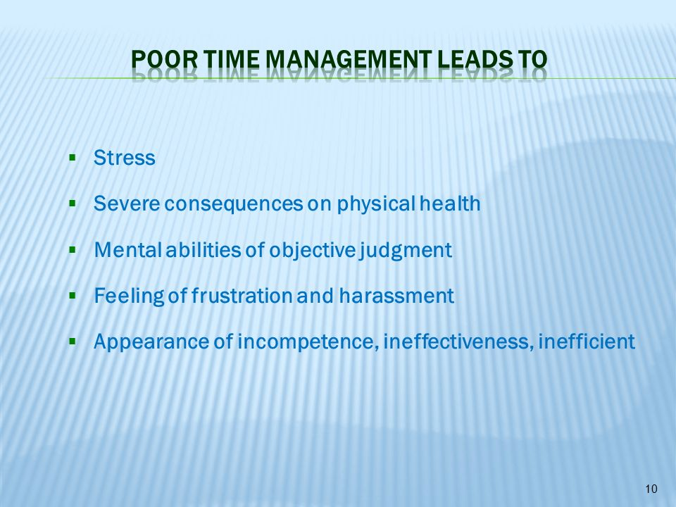
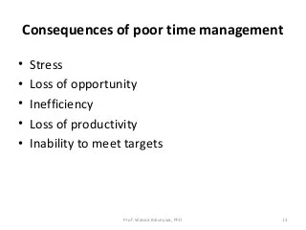

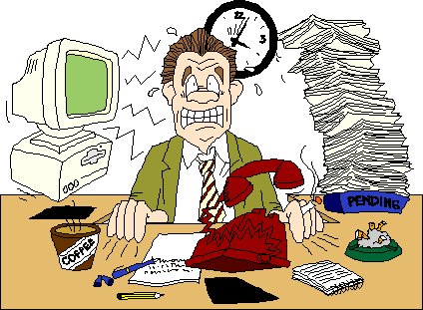

Slide 11


Slide 12
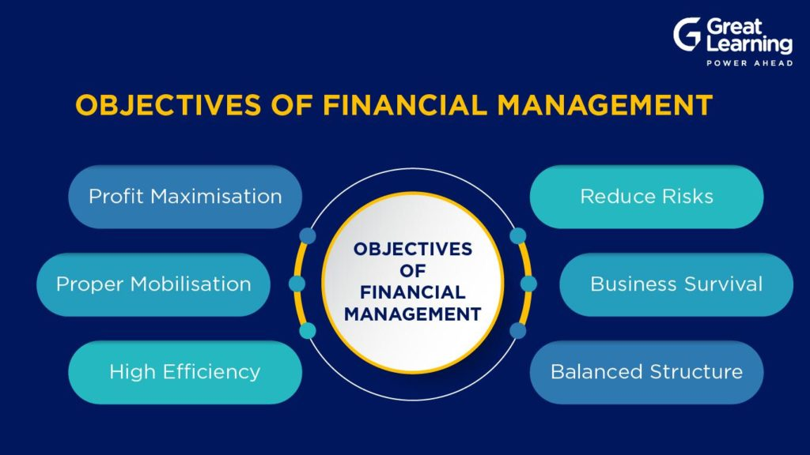

Slide 13
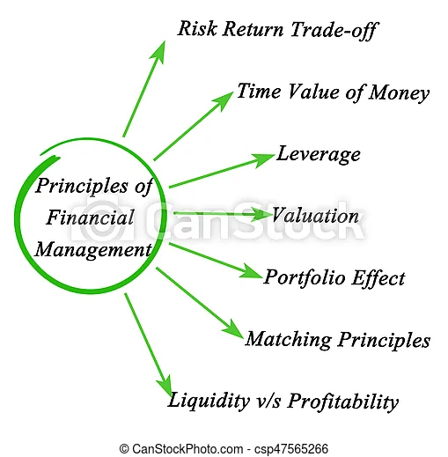

Slide 14
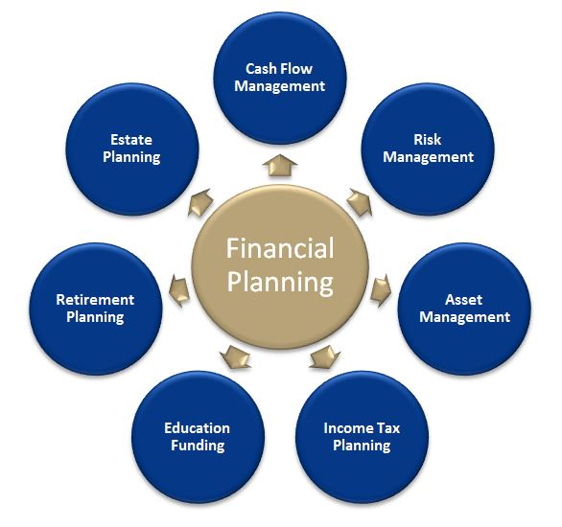

Slide 15


Slide 16


Slide 17


